Slide 1



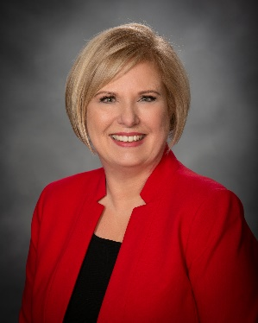






COMPASS COMMERCIAL
Mission & Values
Compass Commercial Advantage
Compass Commercial provides commercial real estate services by advocating for our corporate clients’ interest and decreasing their costs.
Integrity, Diversity, Focus, Positivity
Average Negotiated Savings of 23.2% on Lease/Renewals
Conflict Free Representation for Businesses
Building Owner Pays our Fee
Five Step Beginning to End Proprietary Process
Founder Managed Over 1,500 Real Estate Transactions
Certified Women Owned Business Enterprise
Company Overview
Compass Commercial, ITRA Global was formed in 2010 to exclusively represent business owners’ commercial real estate needs across North America. Recognized as an industry expert and founder, Lynn Drake uses her 30 years of experience in commercial real estate as the basis for creating and streamlining the leasing and buying processes for clients saving them time and money. Lynn Drake is the author of “Do You Speak Lease? And Do You Speak Purchase?”
Core Competencies
Commercial Real Estate Site Selection across North America
Office Lease, Renewal, or Purchase
Industrial Lease, Renewal, or Purchase
Health Care Lease, Renewal, or Purchase
Commercial Real Estate Portfolio Management
Surplus Property Disposition and Analysis
State and Local Incentives
UNSPSC
DUNS#
80130000
039498032
80131502
NAICS CODES
80131503
531210
80131601
531390
ACQUISITION PROCESS
Develop
Search Criteria
Identify and Select Property
Execute Legal Documents
Due Diligence Period
Closing
CAPABILITY STATEMENT
CLIENTS
Compass Commercial, LLC
Lynn Drake, MCR
880 W. Long Lake
Suite 225
Troy, MI 48098
(248) 817-5400
LD@Compass-Commercial.com
https://www.compass-commercial.com/

Slide 2
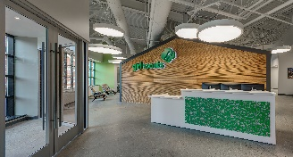
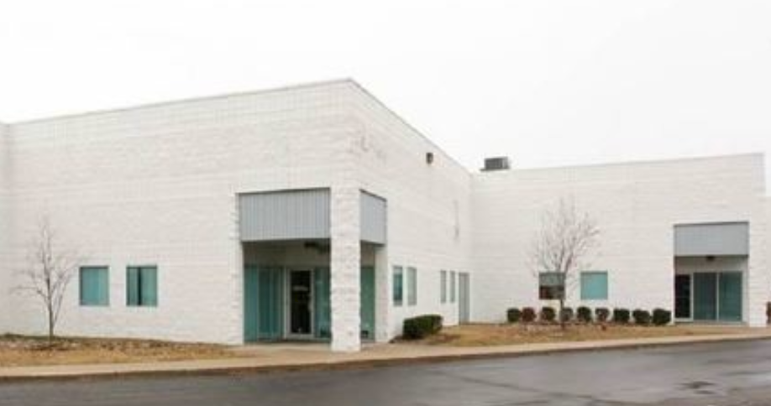
SUCCESS STORIES
Non-Profit Girl Scouts of Southeastern Michigan
Engineering Firm DSA Systems
Relocation Office Space
Lease Renewal Industrial Space
The Challenge
The Challenge
Before covid, the Girl Scouts had been in a long-term lease at the “Fischer building “in Detroit, Michigan. Their rent was significantly over market value, and they had more square footage then they needed.
During covid, the client reached out to Compass Commercial 90 days before their current lease was going to expire. The client needed to consolidate their California operations into their existing suite. Although the existing suite had enough square footage, the space was poorly laid out.
What We Did
More than 20 potential buildings were identified. The team toured 7 buildings and made three requests for proposals. One of the buildings under consideration was the “Fischer building”. The building had been purchased out of bankruptcy, and the new landlord was working to catch up on the maintenance. However, while doing site plans for the space, they discovered that there were so many columns in the proposed space that it could not be laid out very efficiently.
What We Did
We requested a copy of the tenant’s current lease so that we could review the business terms. We met with the client to discuss needed repairs and how to transform the space to a more efficient lay out. A written request for proposal that reflected the client’s needs was prepared.
The Results
The Results
Upon receipt of request for proposals from other property owners, DSA’s landlord agreed to significant concessions.
Negotiations on the remaining locations were completed simultaneously. In the end, they chose 1333 Brewery Park. Compass negotiated the following points on the GS’s behalf:
Recommended changes to the layout allowed the client to add space for 6 new staff members.
Based upon the initial offer, rent was reduced by 23%.
The client was given one month of free rent.
The landlord agreed to replace the carpet, paint the entire office, replace damaged ceiling tiles as needed, clean lights, repair or replace bathroom stalls and toilets as needed, and build a new office with side lights at their expense.
Overall savings to the client including improvements was 47%
Total savings per year in the new location: $305,150/year over a 10-year period for an overall reduction of more than $3M.
New landlord contributed $25.00/s.f. toward the build out.
Tenant signed a 10-year lease with the ability to cancel the lease in the 7th year.
Free parking for all employees and visitors.
Facility includes a loading dock that can be used for loading and unloading cookies.

